Slide 1
Relational Algebra

Slide 2
DBMS Architecture
How does a SQL engine work ?
SQL query → relational algebra plan
Relational algebra plan → Optimized plan
Execute each operator of the plan

Slide 3
Relational Algebra
Formalism for creating new relations from existing ones
Its place in the big picture:
Declartive
query
language
Algebra
Implementation
SQL,
relational calculus
Relational algebra
Relational bag algebra

Slide 4
Relational Algebra
Five operators:
  Union: ∪
  Difference: -
  Selection: σ
  Projection: Π
  Cartesian Product: ×
Derived or auxiliary operators:
  Intersection, complement
  Joins (natural,equi-join, theta join, semi-join)
  Renaming: ρ

Slide 5
1. Union and 2. Difference
R1 ∪ R2
Example:
  ActiveEmployees ∪ RetiredEmployees
R1 – R2
Example:
  AllEmployees -- RetiredEmployees

Slide 6
What about Intersection ?
It is a derived operator
R1 ∩ R2 = R1 – (R1 – R2)
Also expressed as a join (will see later)
Example
  UnionizedEmployees ∩ RetiredEmployees

Slide 7
3. Selection
Returns all tuples which satisfy a condition
Notation: σ_{c}(R)
Examples
  σ_{Salary > 40000} (Employee)
  σ_{name = “Smith”} (Employee)
The condition c can be =, <, ≤, >, ≥, <>

Slide 8
SSN | Name | Salary
1234545 | John | 200000
5423341 | Smith | 600000
4352342 | Fred | 500000
σ_{Salary > 40000} (Employee)
SSN | Name | Salary
5423341 | Smith | 600000
4352342 | Fred | 500000

Slide 9
4. Projection
Eliminates columns, then removes duplicates
Notation: Π _{A1,…,An} (R)
Example: project social-security number and names:
  Π _{SSN, Name} (Employee)
  Output schema: Answer(SSN, Name)

Slide 10
SSN | Name | Salary
1234545 | John | 200000
5423341 | John | 600000
4352342 | John | 200000
Π _{Name,Salary} (Employee)
Name | Salary
John | 20000
John | 60000

Slide 11
5. Cartesian Product
Each tuple in R1 with each tuple in R2
Notation: R1 × R2
Example:
  Employee × Dependents
Very rare in practice; mainly used to express joins

Slide 12
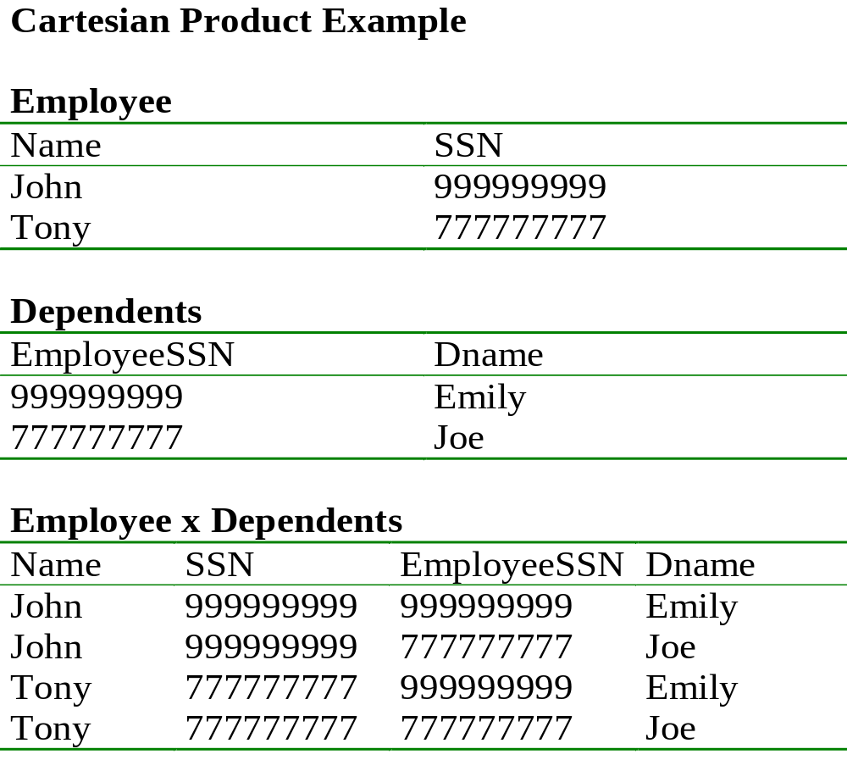

Slide 13
Relational Algebra
Five operators:
  Union: ∪
  Difference: -
  Selection: σ
  Projection: Π
  Cartesian Product: ×
Derived or auxiliary operators:
  Intersection, complement
  Joins (natural,equi-join, theta join, semi-join)
  Renaming: ρ

Slide 14
Renaming
Changes the schema, not the instance
Notation: ρ _{B1,…,Bn} (R)
Example:
  ρ_{LastName, SocSocNo} (Employee)
  Output schema:
  Answer(LastName, SocSocNo)

Slide 15
Renaming Example
Employee
Name
SSN
John
999999999
Tony
777777777
    _{LastName, SocSocNo} (Employee)
LastName
SocSocNo
John
999999999
Tony
777777777

Slide 16
Natural Join
Notation: R1 |×| R2
Meaning: R1 |×| R2 = Π_{A}(σ_{C}(R1 × R2))
Where:
  The selection σ_{C} checks equality of all common attributes
  The projection eliminates the duplicate common attributes

Slide 17
Natural Join Example
Employee
Name
SSN
John
999999999
Tony
777777777
Dependents
SSN
Dname
999999999
Emily
777777777
Joe
Name
SSN
Dname
John
999999999
Emily
Tony
777777777
Joe
Employee Dependents =
Π_{Name, SSN, Dname}(σ _{SSN=SSN2}(Employee x ρ_{SSN2, Dname}(Dependents))

Slide 18
Natural Join
R= S=
R |×| S=
A | B
X | Y
X | Z
Y | Z
Z | V
B | C
Z | U
V | W
Z | V
A | B | C
X | Z | U
X | Z | V
Y | Z | U
Y | Z | V
Z | V | W

Slide 19
Natural Join
Given the schemas R(A, B, C, D), S(A, C, E), what is the schema of R |×| S ?
Given R(A, B, C), S(D, E), what is R |×| S ?
Given R(A, B), S(A, B), what is R |×| S ?

Slide 20
Theta Join
A join that involves a predicate
R1 |×| _{θ} R2 = σ _{θ} (R1 × R2)
Here θ can be any condition

Slide 21
Eq-join
A theta join where θ is an equality
R1 |×| _{A=B} R2 = σ _{A=B} (R1 × R2)
Example:
  Employee |×| _{SSN=SSN} Dependents
Most useful join in practice

Slide 22
Semijoin
R |× S = Π _{A1,…,An} (R |×| S)
Where A₁, …, A_{n} are the attributes in R
Example:
  Employee |× Dependents

Slide 23
Semijoins in Distributed Databases
Semijoins are used in distributed databases
Dependents
Employee
SSN | Dname | Age
. . . |  | . . .
SSN | Name
. . . | . . .
network
Employee |× _{ssn=ssn} (σ _{age>71} (Dependents))
T = Π _{SSN} σ _{age>71} (Dependents)
R = Employee |× T
Answer = R |×| Dependents

Slide 24
Complex RA Expressions
Π _{name}
buyer-ssn=ssn
pid=pid
seller-ssn=ssn
Π _{ssn}
Π _{pid}
σ_{name=fred}
σ_{name=gizmo}
Person Purchase Person Product

Slide 25
Operations on Bags
A bag = a set with repeated elements
All operations need to be defined carefully on bags
{a,b,b,c}∪{a,b,b,b,e,f,f}={a,a,b,b,b,b,b,c,e,f,f}
{a,b,b,b,c,c} – {b,c,c,c,d} = {a,b,b,d}
σ_{C}(R): preserve the number of occurrences
Π_{A}(R): no duplicate elimination
Cartesian product, join: no duplicate elimination
Important ! Relational Engines work on bags, not sets !

